Slide 1
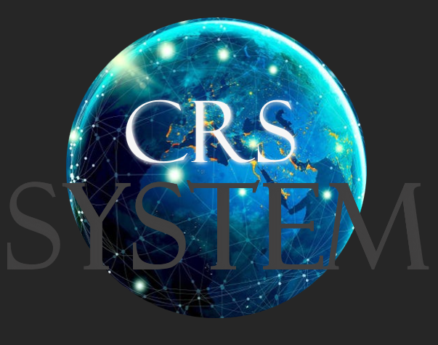
Created by:
Ndiaye, Bachir
Lester, Shantal
Sierra Perez, Christian

Slide 2
As a team we came to the conclusion that this project would take 4 - 6 months complete.
What is CRS ?
Caribbean Rate Software
CRS is an exchange rate monitoring software system that will be the main platform that is accessible to customers, all banks and financial institutions, and the Central Bank in the country.

Slide 3
Features of CRS
Efficiency in monitoring rates
Allow users to request rates
Ranks transactions into “Tiers”
Can be utilized by many different types of user

Slide 4

CRS System
Benefits:
Accessible
Versatile
Secure
Easy to maintain

Slide 5

Costs
The cost can vary. It depends on:
The complexity of the project
The number of features and functionality requires
Platform use to develop and deploy software
Expertise of each team members
Region (New York)

Slide 6
Project cost is approximately $400,000 - 600,000
Developers salary (3) - $180,000
Using an in-house database and software cost approximately - $30,000
Training employees - ($40 per person)
Communication cost - $1,900
Transportation, etc.

Slide 7

Tangible benefits:
Increase in revenue for the central bank as more institutions will participate in the system
Increase in productivity as more banks will be able to transfer currency
Increased information on transaction history of other banks and customers
Intangible benefits:
Having a system up to regulation will enhance the reputation of the central bank
Additionally customer satisfaction will increase by providing a streamlined system

Slide 8

Risks:
Security Risk- It is most important that when creating
a system like CRS, it is essential to ensure the software
is built to prevent theft, fraud and unauthorized access.
Operations Risk - A system handling currency for financial
institutions must be reliable. Any downtime or operational
issues could lead to loss of revenue.
Low Productivity - Integrating a new system like CRS across multiple banks can hinder productivity

Slide 9

Stakeholders
Jefferson Bien-Aime
Customer
Central Bank
Banks and Financial Institutions
Trade Analyst
Risk Officer
Head of Foreign Exchange Officer
Foreign Exchange Officer
A person or group that has an interest in the development of the CRS System and can either affect or be affected by the outcome/business.

Slide 10
Risk Management
Stakeholder Management
Communication Management
the ongoing process of identifying, analyzing, evaluating, and treating loss exposures, as well as monitoring risk control and financial resources to limit the negative consequences of loss.
Ensure that project material is generated, collected, stored, and disposed of promptly and suitably.
Stakeholders must be communicated with on a regular basis. Stakeholders' needs and expectations must be understood.

Slide 11

Methodology Used
We choose Scrum as our methodology because it allows us to focus on delivering the highest business value in the shortest time.
Repeatedly inspect working software (every two weeks - month) using series of sprints
Team self organized
Continue to enhance software every sprint

Slide 12

Understanding the roles of the:
Customers
Companies
Providers
Central Bank
Meeting with stakeholder
Team meetings

Slide 13
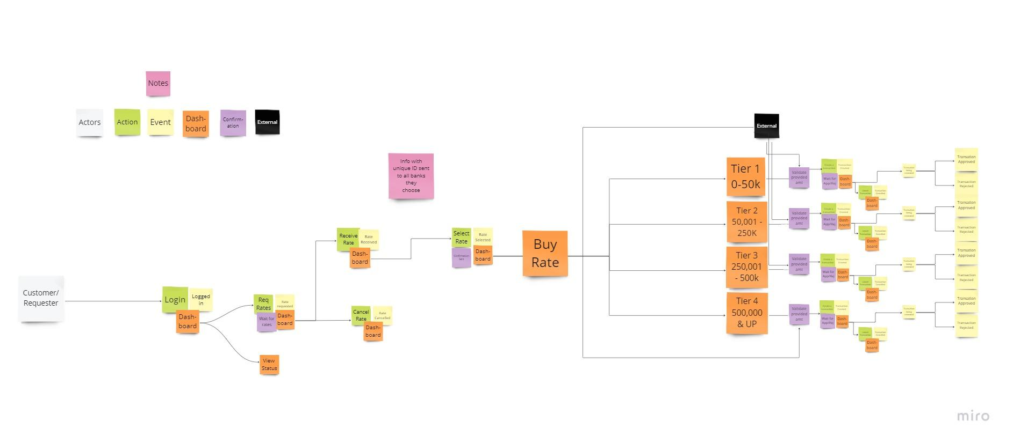
Story Mapping
Maps out the Business Process from the user perspective. Visual representation of the information we gathered.

Slide 14
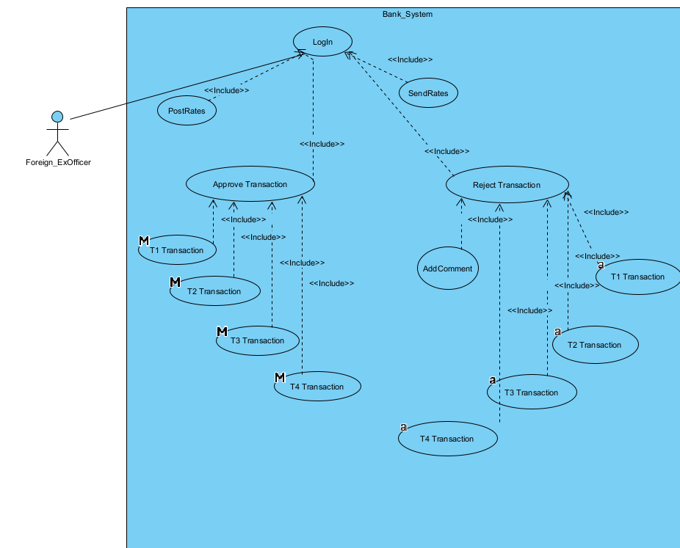
Use Case Diagram
A display of how the Banks/Financial institutions will use the system.
We also have:
A customer System
Company System
Provider/Bank System
Central Bank System
And a system for on-boarding

Slide 15
Conclusion
CRS is an exchange rate monitoring software designed for the Central Bank of the Caribbean. As a team we will implement a process of designing, developing, testing, and maintaining the software.
We created other diagrams such as:
Class Diagram
State Diagram
Activity Diagram
Sequence DIagram

